Slide 1
PORTFOLIO
WEBSITE

Slide 2

TEAM-
V HARSHA VARDHAN
AP22110010677
CONCEPT USED – HTML, CSS, JAVA_SCRIPT
-FOR BETTER EXPERIENCE USE POWERPOINT SLIDE SHOW

Slide 3

C
Uses of creating of portfolio website
Professional Presence:
It establishes a professional online presence that showcases your skills, expertise, and achievements.
Showcase Projects and Skills:
It provides a platform to display completed projects. This can include coding projects, designs, artworks, writings, or any other relevant work.
B
Some potential problem motivations
Personal Branding & Professional Presentation:
Motivation:
Establishing a strong online presence and showcasing professional skills and achievements.
Objective:
To create a visually appealing and informative portfolio that reflects Harsha's capabilities.
A
WHAT IS A PORTFOLIO?
A portfolio, in the context of professional or creative fields, refers to a collection of work that showcases your skills, experience, and achievements. It serves as a comprehensive representation of your abilities and accomplishments relevant to a specific career or industry

Slide 4
A
WHAT IS A PORTFOLIO?
A portfolio, in the context of professional or creative fields, refers to a collection of work that showcases your skills, experience, and achievements. It serves as a comprehensive representation of your abilities and accomplishments relevant to a specific career or industry
B
Some potential problem motivations
Personal Branding & Professional Presentation:
Motivation:
Establishing a strong online presence and showcasing professional skills and achievements.
Objective:
To create a visually appealing and informative portfolio that reflects Harsha's capabilities.
C
Uses of creating of portfolio website
Professional Presence:
It establishes a professional online presence that showcases your skills, expertise, and achievements.
Showcase Projects and Skills:
It provides a platform to display completed projects. This can include coding projects, designs, artworks, writings, or any other relevant work.

Slide 5
This C++ code implements a classic Snake game using the Turbo C++ graphics library. The game provides a graphical environment in which players control a snake with the goal of eating eggs to score points and grow the snake's length. The game features intuitive keyboard controls, sound effects, and the ability to pause and resume gameplay.
Key Features:
Graphic representation of the game with a snake and eggs.
Keyboard input to control the snake's movement (up, down, left, right).
Scoring system that increases as the snake consumes eggs.
Game speed that gradually increases, making the game more challenging.
Sound effects to enhance the gaming experience.
Pause, resume, and exit game functionality.
How the Game Works:
The player controls the snake's direction using arrow keys.
The objective is to guide the snake to eat eggs that appear on the screen.
•Each time the snake consumes an egg, the player's score increases, and the snake's length grows.
•The game continues until the snake collides with the game boundaries or itself, resulting in a "Game Over" scenario.
•The player can pause, resume, or exit the game using keyboard commands.
INTRODUCTION

Slide 6

Welcome to the presentation of my portfolio website project. This project represents a culmination of my skills, creativity, and passion for EDUNET and SRM-AP UNIVERSITY. The purpose of this website is to showcase my professional journey, projects, and expertise in a visually engaging and informative manner.
Embedded within this portfolio are links to my LinkedIn profile, GitHub repository, and resume, serving as comprehensive resources for further exploration of my professional background, technical proficiency, and project contributions.
Whether you are a prospective client, employer, or industry peer, I invite you to navigate through this presentation to gain insights into my skillset, achievements, and aspirations. Together, let us delve into the meticulous craftsmanship and strategic intent behind this portfolio website, aimed at encapsulating my professional identity and accomplishments.

Slide 7
Welcome to the presentation of my portfolio website project. This project represents a culmination of my skills, creativity, and passion for EDUNET and SRM-AP UNIVERSITY. The purpose of this website is to showcase my professional journey, projects, and expertise in a visually engaging and informative manner.
Things which are Embedded within this portfolio are links to my LinkedIn profile, GitHub repository, and resume, serving as comprehensive resources for further exploration of my professional background, technical proficiency, and project contributions.
Whether you are a prospective client, employer, or industry peer, I invite you to navigate through this presentation to gain insights into my skillset, achievements, and aspirations. Together, let us delve into the meticulous craftsmanship and strategic intent behind this portfolio website, aimed at encapsulating my professional identity and accomplishments.

Slide 8
Welcome to the presentation of my portfolio website project. This project represents a culmination of my skills, creativity, and passion for EDUNET and SRM-AP UNIVERSITY. The purpose of this website is to showcase my professional journey, projects, and expertise in a visually engaging and informative manner.
Things which are Embedded within this portfolio are links to my LinkedIn profile, GitHub repository, and resume, serving as comprehensive resources for further exploration of my professional background, technical proficiency, and project contributions.
Whether you are a prospective client, employer, or industry peer, I invite you to navigate through this presentation to gain insights into my skillset, achievements, and aspirations. Together, let us delve into the meticulous craftsmanship and strategic intent behind this portfolio website, aimed at encapsulating my professional identity and accomplishments.

Slide 9
This C++ code implements a classic Snake game using the Turbo C++ graphics library. The game provides a graphical environment in which players control a snake with the goal of eating eggs to score points and grow the snake's length. The game features intuitive keyboard controls, sound effects, and the ability to pause and resume gameplay.
Key Features:
Graphic representation of the game with a snake and eggs.
Keyboard input to control the snake's movement (up, down, left, right).
Scoring system that increases as the snake consumes eggs.
Game speed that gradually increases, making the game more challenging.
Sound effects to enhance the gaming experience.
Pause, resume, and exit game functionality.
How the Game Works:
The player controls the snake's direction using arrow keys.
The objective is to guide the snake to eat eggs that appear on the screen.
•Each time the snake consumes an egg, the player's score increases, and the snake's length grows.
•The game continues until the snake collides with the game boundaries or itself, resulting in a "Game Over" scenario.
•The player can pause, resume, or exit the game using keyboard commands.
END USERS
Potential Employers
Clients
Colleagues and Peers
Academic Institutions
Recruiters
Mentors and Advisors
Friends and Family
General Public

Slide 10

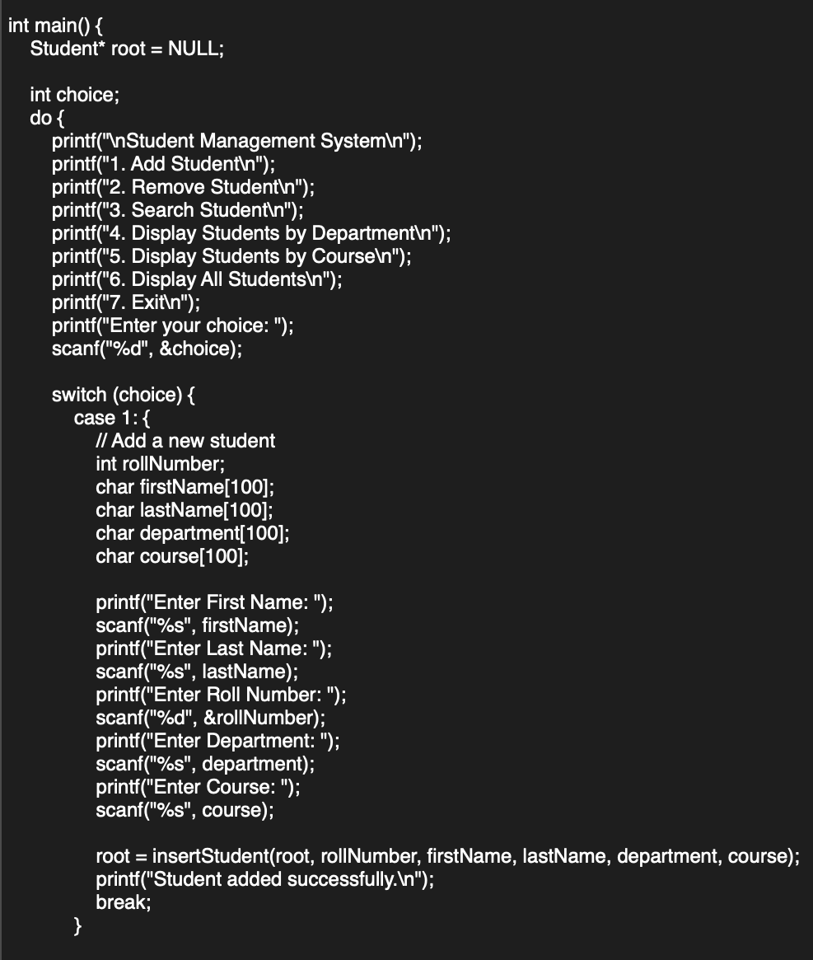
PROBLEM STATEMENT
Create a personal portfolio website for Harsha. Here are the key aspects and functionalities of the website:
Header and Navigation
Main Sections
Project Section
Styling and Design
Footer
HEADER AND NAVIGATION
Header (<header>): Contains branding or introductory elements.
Navigation (<nav>): Provides links (<a> tags) to different sections:
Home: index.html
Resume: resume.html
LinkedIn: External link to LinkedIn profile.
GitHub: External link to GitHub profile.
Contact Me: Typically a contact page or form.
MAIN SECTION
Introduction Section
(<section class="firstSection">):
Introduces Harsha with a dynamic element (<span id="element">)
showing different roles.
Includes a visual element (image) in rightSection.

Slide 11
PROBLEM STATEMENT
Create a personal portfolio website for Harsha. Here are the key aspects and functionalities of the website:
Header and Navigation
Main Sections
Project Section
Styling and Design
Footer
HEADER AND NAVIGATION
Header (<header>): Contains branding or introductory elements.
Navigation (<nav>): Provides links (<a> tags) to different sections:
Home: index.html
Resume: resume.html
LinkedIn: External link to LinkedIn profile.
GitHub: External link to GitHub profile.
Contact Me: Typically a contact page or form.
MAIN SECTION
Introduction Section
(<section class="firstSection">):
Introduces Harsha with a dynamic element (<span id="element">)
showing different roles.
Includes a visual element (image) in rightSection.

Slide 12
PROBLEM STATEMENT
Create a personal portfolio website for Harsha. Here are the key aspects and functionalities of the website:
Header and Navigation
Main Sections
Project Section
Styling and Design
Footer
HEADER AND NAVIGATION
Header (<header>): Contains branding or introductory elements.
Navigation (<nav>): Provides links (<a> tags) to different sections:
Home: index.html
Resume: resume.html
LinkedIn: External link to LinkedIn profile.
GitHub: External link to GitHub profile.
Contact Me: Typically a contact page or form.
MAIN SECTION
Introduction Section
(<section class="firstSection">):
Introduces Harsha with a dynamic element (<span id="element">)
showing different roles.
Includes a visual element (image) in rightSection.

Slide 13
PROJECT SECTION
Projects Completed:
Snakey Adventures (C++)
Description: A classic Snake game using Turbo C++ Graphics Interface.
Portfolio Website (HTML, CSS, JS)
Description: A responsive website showcasing my skills and projects.
Student Management System (C)
Description: Software application utilizing Binary Search Tree for managing student data.
STYLING
The website is styled with a dark theme
(body background-colour: rgb(5, 5, 25);
Navigation links change colour on hover
(nav ul li a:hover).
Sections have specific styling
(firstSection, secondSection) with appropriate margins, alignments, and font sizes.
FOOTER:
Includes a footer (<footer>) with sections for navigation links duplicated from the header and a copyright notice (footer-rights).
EXTERNAL DEPENDENCIES:
Uses Google Fonts (Karla font family) and Typed.js library for animated typing effect.

Slide 14
PROJECT SECTION
Projects Completed:
Snakey Adventures (C++)
Description: A classic Snake game using Turbo C++ Graphics Interface.
Portfolio Website (HTML, CSS, JS)
Description: A responsive website showcasing my skills and projects.
Student Management System (C)
Description: Software application utilizing Binary Search Tree for managing student data.
STYLING
The website is styled with a dark theme
(body background-colour: rgb(5, 5, 25);
Navigation links change colour on hover
(nav ul li a:hover).
Sections have specific styling
(firstSection, secondSection) with appropriate margins, alignments, and font sizes.
FOOTER:
Includes a footer (<footer>) with sections for navigation links duplicated from the header and a copyright notice (footer-rights).
EXTERNAL DEPENDENCIES:
Uses Google Fonts (Karla font family) and Typed.js library for animated typing effect.

Slide 15
PROJECT SECTION
Projects Completed:
Snakey Adventures (C++)
Description: A classic Snake game using Turbo C++ Graphics Interface.
Portfolio Website (HTML, CSS, JS)
Description: A responsive website showcasing my skills and projects.
Student Management System (C)
Description: Software application utilizing Binary Search Tree for managing student data.
STYLING
The website is styled with a dark theme
(body background-colour: rgb(5, 5, 25);
Navigation links change colour on hover
(nav ul li a:hover).
Sections have specific styling
(firstSection, secondSection) with appropriate margins, alignments, and font sizes.
FOOTER:
Includes a footer (<footer>) with sections for navigation links duplicated from the header and a copyright notice (footer-rights).
EXTERNAL DEPENDENCIES:
Uses Google Fonts (Karla font family) and Typed.js library for animated typing effect.

Slide 16
TECHNOLOGIES USED
Frontend:
HTML - To structure a web page and its content
CSS - To style and layout web pages
JavaScript - To create dynamic webpages
Additional Tools:
Typed.js for dynamic text animation and Google Fonts for typography enhancements.
FUTURE PLANS
Future Plans:
Enhanced Portfolio Section:
Expand portfolio with new projects and case studies.
Showcase more diverse skills and technologies.
Interactive Features:
we can Implement a blog section to share insights, tutorials, and project updates.
Accessibility Improvements:
Ensure accessibility standards compliance for all users.
CONCLUSION
Achievements:
Presented my portfolio website showcasing skills in web development.
Projects:
Highlighted completed projects including Snakey Adventures, Portfolio Website, and Student Management System.
Future Plans:
Outlined future plans to enhance portfolio sections, implement interactive features.

Slide 17
TECHNOLOGIES USED
Frontend:
HTML - To structure a web page and its content
CSS - To style and layout web pages
JavaScript - To create dynamic webpages
Additional Tools:
Typed.js for dynamic text animation and Google Fonts for typography enhancements.
FUTURE PLANS
Future Plans:
Enhanced Portfolio Section:
Expand portfolio with new projects and case studies.
Showcase more diverse skills and technologies.
Interactive Features:
we can Implement a blog section to share insights, tutorials, and project updates.
Accessibility Improvements:
Ensure accessibility standards compliance for all users.
CONCLUSION
Achievements:
Presented my portfolio website showcasing skills in web development.
Projects:
Highlighted completed projects including Snakey Adventures, Portfolio Website, and Student Management System.
Future Plans:
Outlined future plans to enhance portfolio sections, implement interactive features.

Slide 18
TECHNOLOGIES USED
Frontend:
HTML - To structure a web page and its content
CSS - To style and layout web pages
JavaScript - To create dynamic webpages
Additional Tools:
Typed.js for dynamic text animation and Google Fonts for typography enhancements.
FUTURE PLANS
Future Plans:
Enhanced Portfolio Section:
Expand portfolio with new projects and case studies.
Showcase more diverse skills and technologies.
Interactive Features:
we can Implement a blog section to share insights, tutorials, and project updates.
Accessibility Improvements:
Ensure accessibility standards compliance for all users.
CONCLUSION
Achievements:
Presented my portfolio website showcasing skills in web development.
Projects:
Highlighted completed projects including Snakey Adventures, Portfolio Website, and Student Management System.
Future Plans:
Outlined future plans to enhance portfolio sections, implement interactive features.

Slide 19

THANK YOU

